Slide 1
CWave
a basic Synthesizer made using C.
​Made by Pranav Prabhakar
Contributors: Prema P Kotur, Pranav Chandrasekar

Slide 2
What is CWave?

Slide 3
What is CWave?
CWave is a simple synthesizer, made in C. It lets you play and record sounds using your computer keyboard or a MIDI device.

Slide 4
Different waveforms

Slide 5
Different waveforms
Volume and octave control

Slide 6
Different waveforms
Volume and octave control
Using a keyboard to control

Slide 7
Different waveforms
Volume and octave control
Using a keyboard to control
Recording sessions

Slide 8
includes and definitions

Slide 9
includes and definitions
#include <stdio.h>
#include <stdlib.h>
#include <math.h>
#include <Windows.h>
#include <mmsystem.h>
#include "portaudio.h"
#pragma comment(lib, "winmm.lib")

Slide 10
data structures

Slide 11
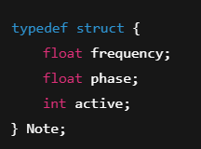
data structures
typedef enum { WAVE_SINE, WAVE_SQUARE, WAVE_SAW } Waveform;

Slide 12
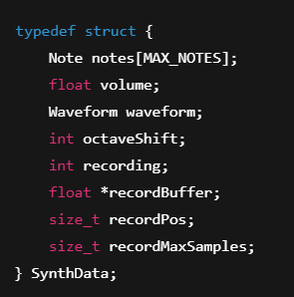
data structures
Synth structure for defining waveforms (kinda important)

Slide 13
note handling

Slide 14
note handling
"equal temperament tuning"

Slide 15


note handling
midiNoteToFreq turns a MIDI note number into a real sound frequency.
note_on(freq) – starts playing a note at that frequency, sets active = 1
note_off(freq) – stops playing it, sets active = 0

Slide 16
MIDI callback

Slide 17

MIDI callback
Checks the message to see if it’s a Note On or Note Off
Then it calls:
  note_on() – if the note should start playing
  note_off() – if the note should stop playing.

Slide 18
waveform generator

Slide 19
waveform generator
frequency
sine
time
square
waveform
sawtooth

Slide 20
Recording to WAV
saves files in this format:
recording1.wav
recording2.wav
Recording3.wav
and so on.

Slide 21
PortAudio Callback

Slide 23

keyboard interaction
Monitors key states using GetAsyncKeyState().
Plays notes based on keys A–K and W–U.
Adjusts volume (+/-).
Changes waveform (Z, X, C).
Shifts octaves (↑, ↓).
Toggles recording (R).

Slide 24
GetFrequencyForKey
how your computer keyboard becomes a piano

Slide 25

GetFrequencyForKey
how your computer keyboard becomes a piano

Slide 26
main function - int main()

Slide 27
Main Function - int main()
3. Main loop:
  Watches for keyboard input (like computer keys)
  If you press ESC, it stops the loop and shuts everything down
4. When you're done:
  Closes MIDI + audio connections
  Shuts down PortAudio
  Saves any recording you were making to a WAV file
What It Does:
Starts things up:
  Initializes PortAudio (for sound output )
  Sets up MIDI input (to listen to your keyboard/MIDI controller )
Begins audio playback:
  Starts the audio stream
  Enters a loop to keep the synth running

Slide 29

thank you

